Slide 1
Forecasting the Next Event Time
By: Ajayi Gbemisola
DataLab Analytics Internship Program, April. 2023

Slide 2
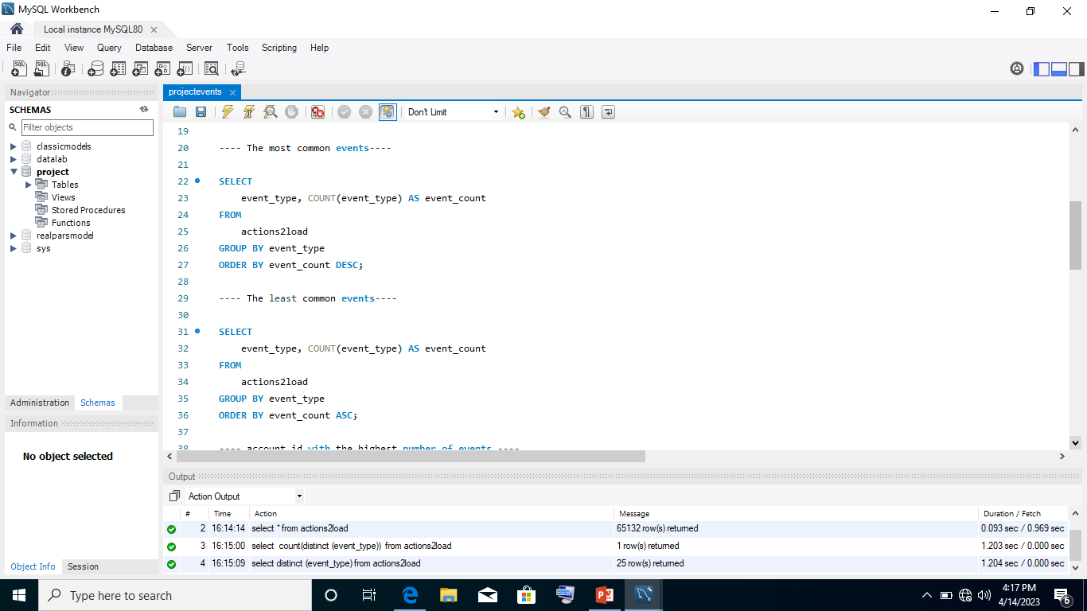
Analyzing Customer Behaviour Using MySQL Database
The whole dataset was loaded into MySQL database.
An aggregation of the data was carried out to get an overview of what events are in the database.
The following questions were further answered using SQL Queries:
What events are most common?
What events are least common?

Slide 3
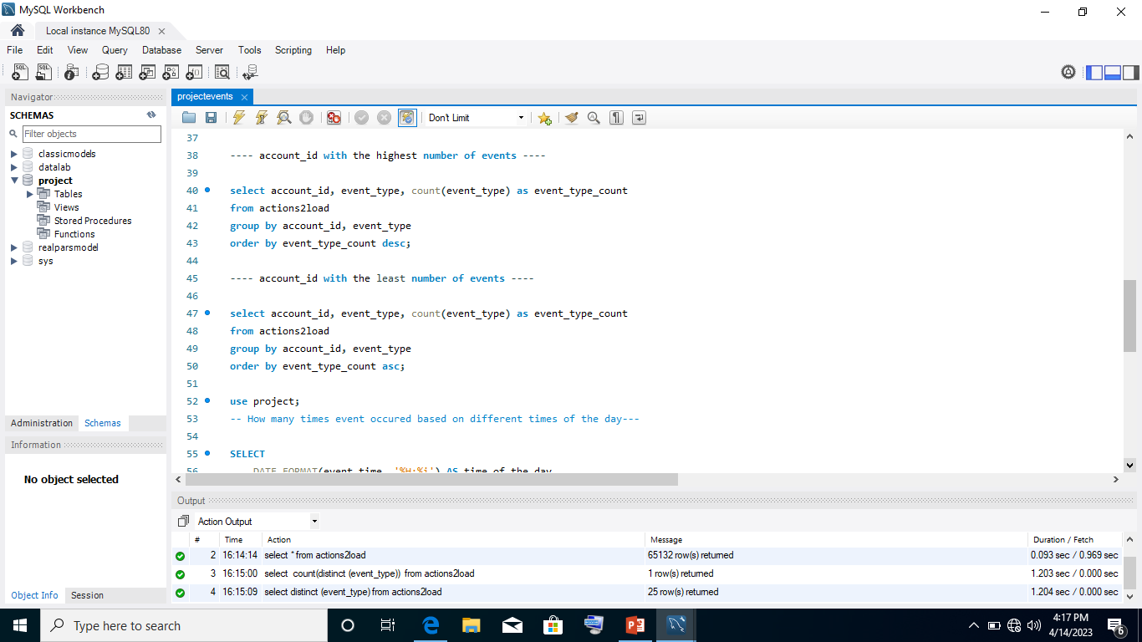
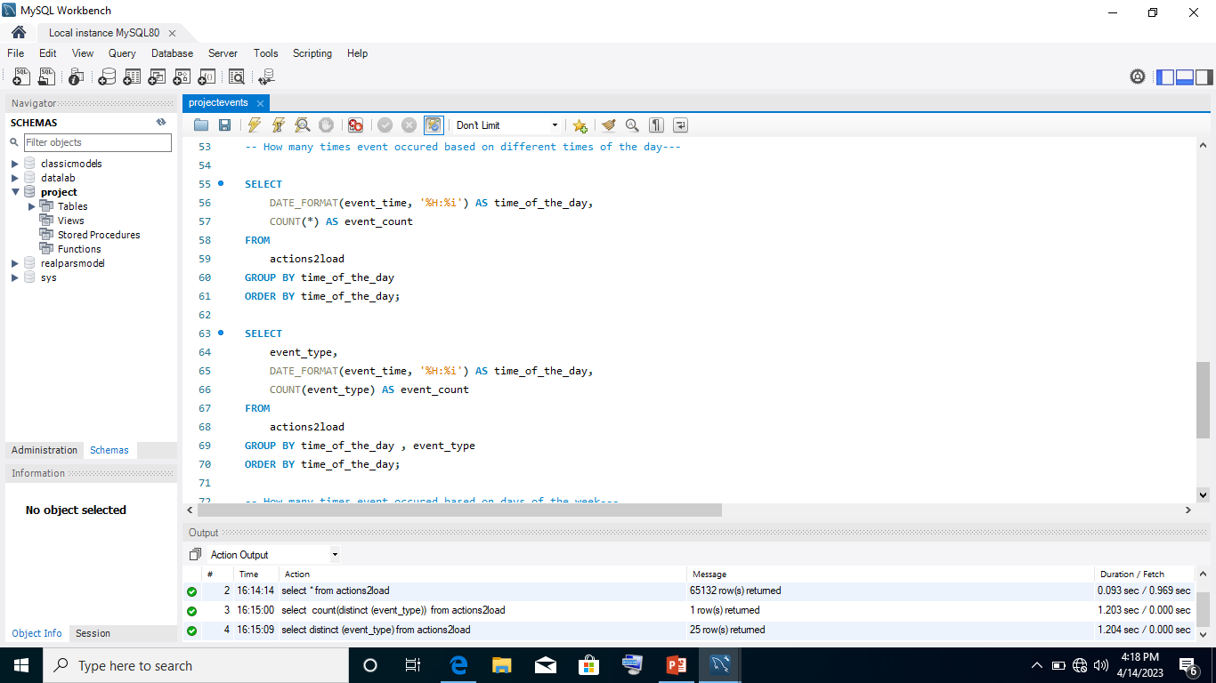
Analyzing Customer Behaviour Using MySQL Database
The following questions were further answered using SQL Queries:
Account id with the highest number of events
Account id with the least number of events
The number of time event occurred based on different times of the day

Slide 4
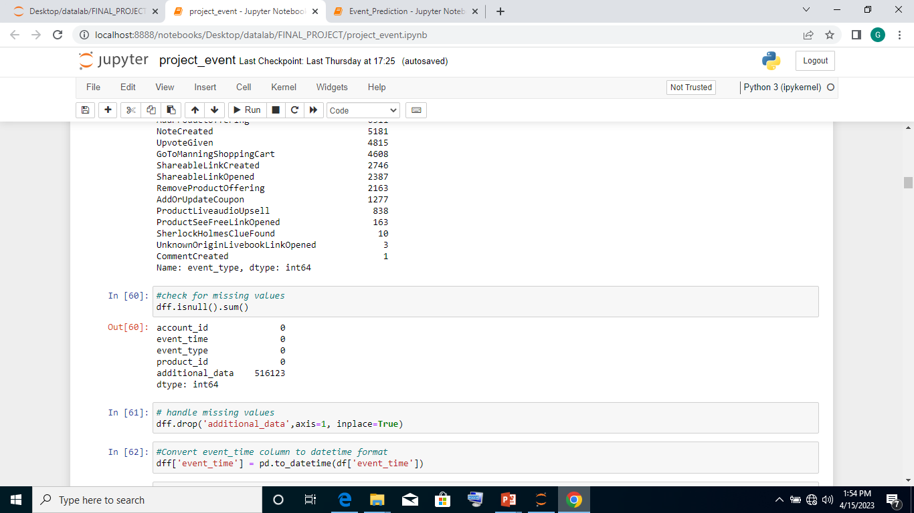
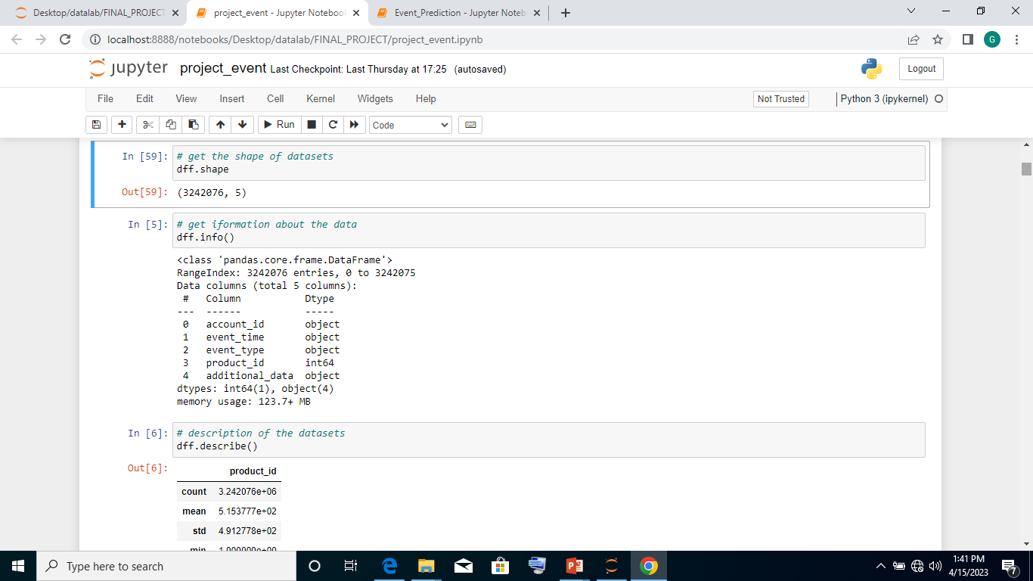
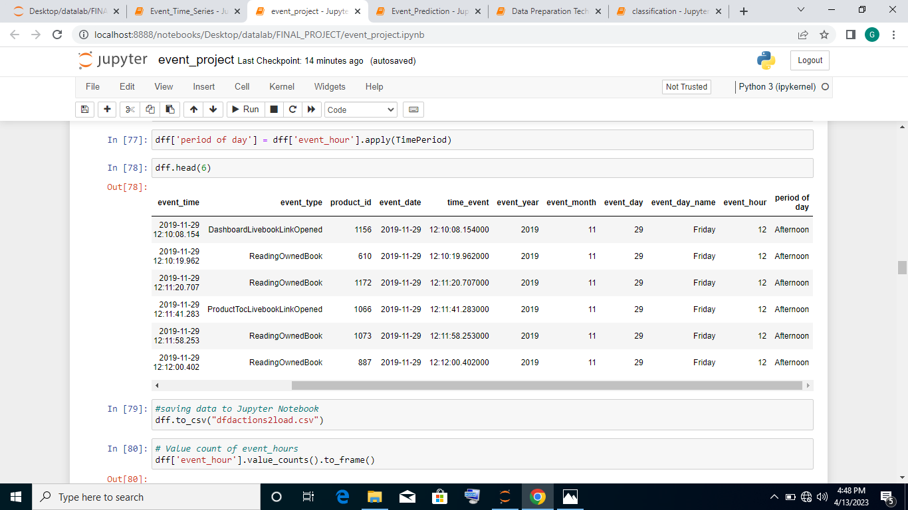
Data Preparation and Data Quality Assurance Using Python
The whole dataset was imported into Jupyter Notebook .
The datasets contains 3242076 rows and 5 rows
The missing value was checked for and the column was dropped to scale down the data due to my computing resources, since it has no effect on the output of the datasets.
Afterward, the event_time feature was converted to datetime data type.
Feature engineering was carried out and this resulted into more features added to the datasets ( event_date, time_event, event_day, event_day_name, event_month,, event_year, event_hour, Period of day).
Outliers were removed from the dataset using Inter Quartile Range (IQR) technique.

Slide 5
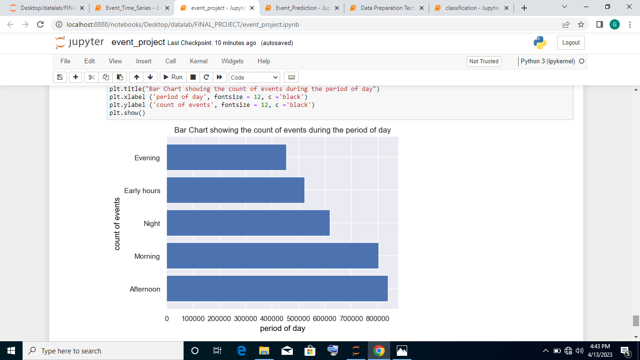
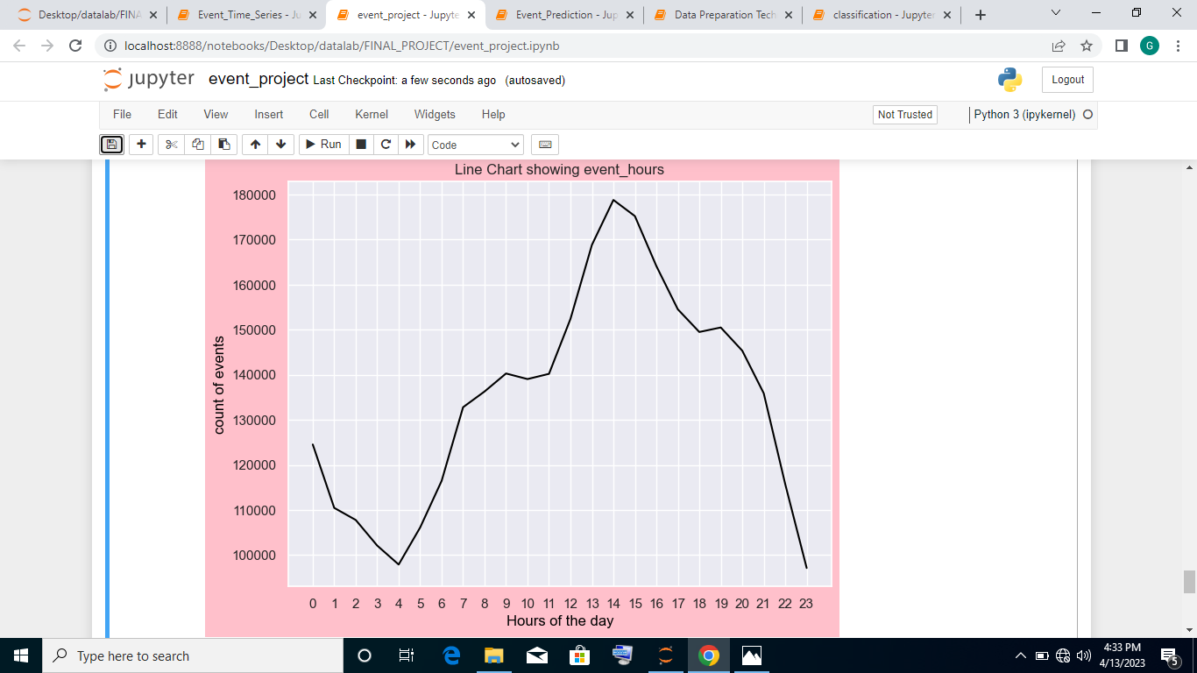

Pattern Recognition Check on “Events” Using Python
Pattern Recognition check was carried out on “events” to see the events that happens at different times of the day.
This was checked by plotting a bar chart to show the count of events during the period of the day and a line chart showing the count of event_hours.
Also, a particular account_id was analysed for insights on how the person uses the service at different times of the day.

Slide 6
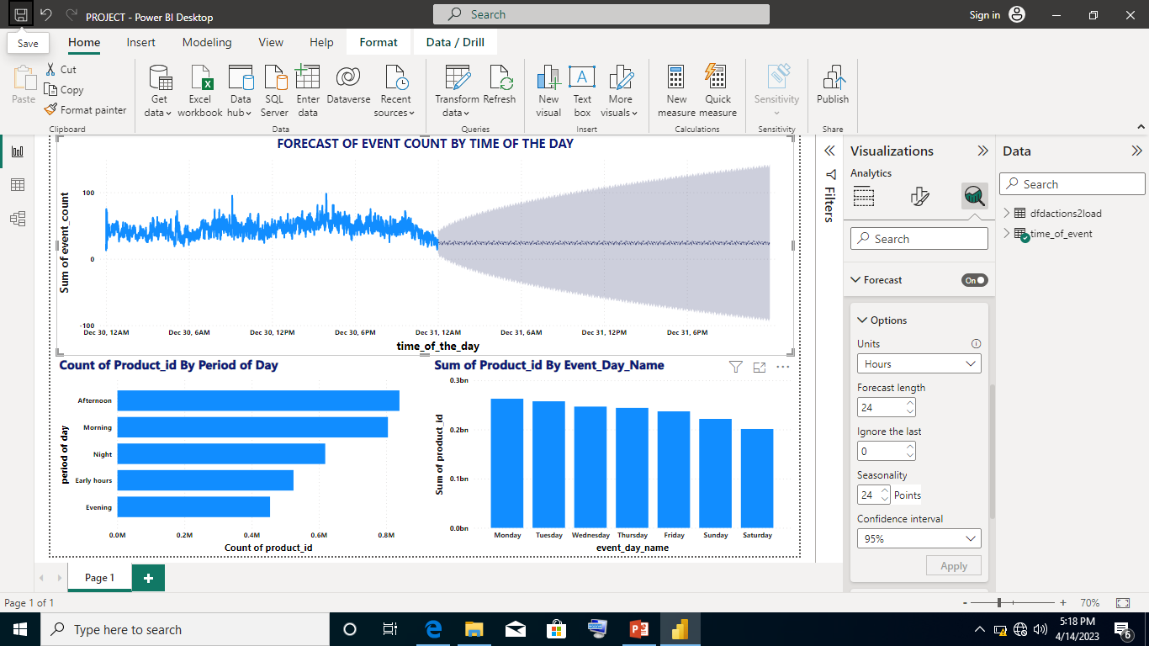
Forecasting “event count” for different times of the day for the next 24 hours using Power BI
Data extracted from previous SQL query was loaded into Power Bi for forecasting of event count.
The following forecasting settings was used :
Forecast length: 24 hours
Ignore the last:0
Seasonality: 24 points
Confidence Interval: 95%
Reason: The above forecast settings gave the best prediction of the event come over the period of 24 hours.

Slide 7
What Information Could Improve the Forecasting
Information on continuous variables relating to the event type that was carried out
Information on further activities or transactions carried out by account_id’s using various event can be useful in predicting the future event time count.
More historical data with useful information about the event type is needed to capture patterns or trends in the event type.

